Slide 1
Teaching Advanced Word 2007
Carol M. Cram
Capilano University
North Vancouver, BC

Slide 2
Overview
Teaching Advanced Word Skills
Developing Multipage Documents
Exploring Advanced Graphics
Working with References
Building Forms
Customizing Word

Slide 3
Teaching Advanced Word Skills
Encourage experimentation
Provide opportunities for problem-solving
Share techniques that improve efficiency
  Format Painter
  Styles
  Macros

Slide 4
Assignments
Textbook assignments to learn the features
Skills Reviews to review features
Independent Challenges
  Creating documents “from scratch”
  Editing and reformatting

Slide 5
Workshop Format
Review of Features
  Definitions
  Applications
Demonstration
Practice

Slide 6
Developing Multipage Documents
Styles
Outlining
Sections
Table of Contents
Cover Page
Master Documents

Slide 7
Exploring Styles
Use styles to automate document-formatting tasks and to ensure consistency between related documents
  A style consists of various formats such as font style, font size, and alignment that are combined into one set that you name

Slide 8
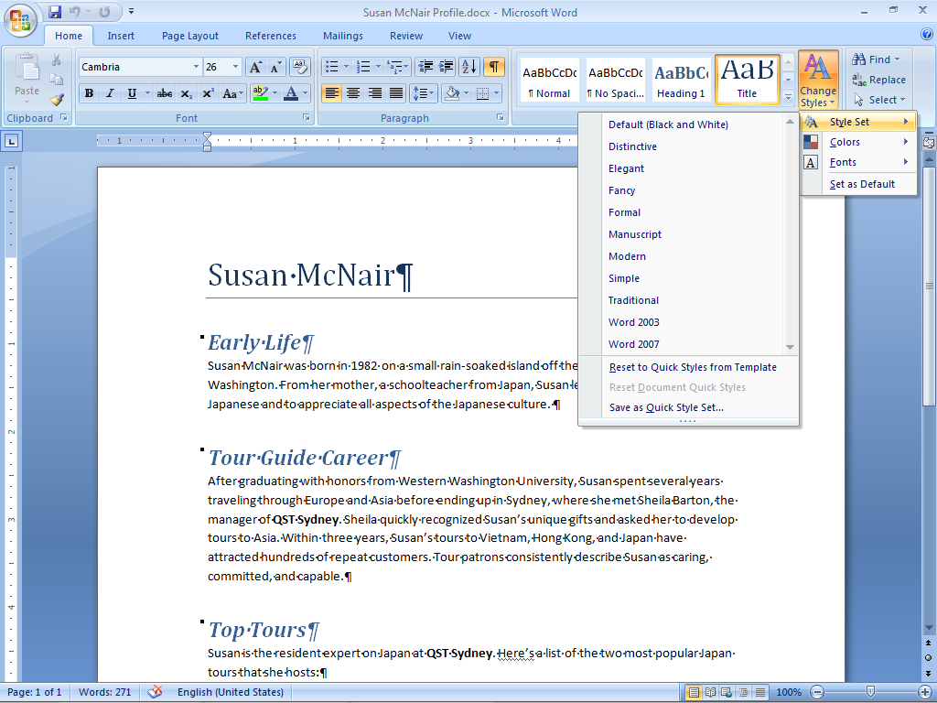
Exploring Styles
Styles Gallery
Document formatted with the Word 2007 Quick Style set, which is applied to all new documents

Slide 9

Exploring Styles
Four style categories:
  Paragraph: includes character and paragraph formats
  Character: includes character styles only
  List: includes styles to format a series of lines with numbers or bullets
  Table: includes styles to format a table grid and text
Demonstration
Notes:
Click Demonstration and go through requirements in text:
Change Quick Style Set: choose Fancy
Change Heading 1 style; update
Add search and replace – search for QST and replace with QST with Company character style
Update Normal style – remove italics
Create new Quick Style set =- called Conference
Change Color Scheme – note that color scheme does not go with a Quick Style set
They work

Slide 10
Building a Document in Outline View
Use Outline View to organize headings and subheadings that identify topics and subtopics
  Assign each heading a level from 1 to 9, with Level 1 being the highest level
  Assign the Body Text level to the paragraphs
  Move or delete blocks of text

Slide 11
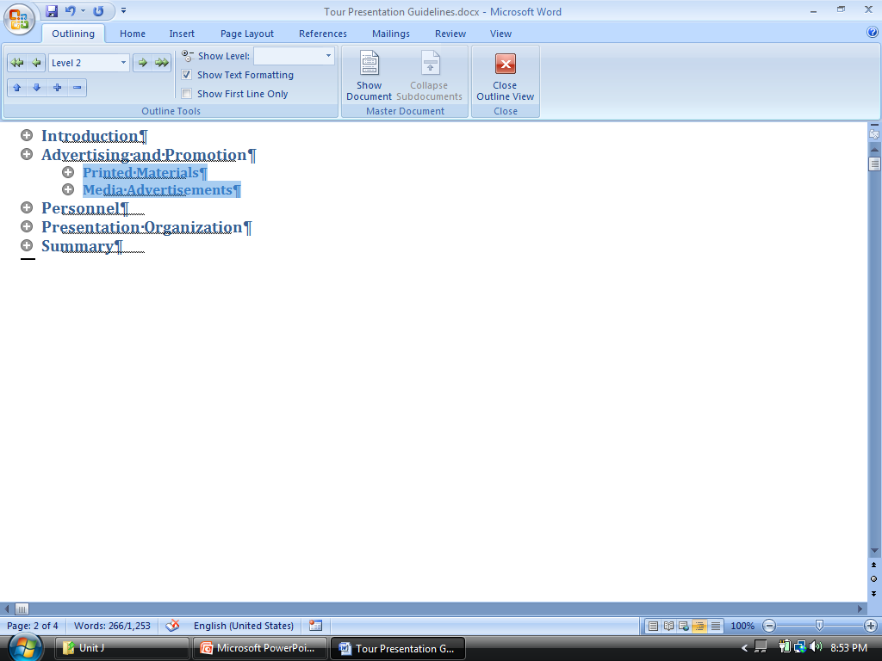
Working in Outline View
Show Level
list arrow
Move Up
button
Expand
button
Collapse
button
Plus outline symbol indicates that
additional levels or paragraphs of text
are included under the heading
Notes:
What are the applications?

Slide 12
Working With Sections
Multi-page documents often consist of two or more sections, each of which can be formatted differently
  Header text and page numbers can be different in each section
  Deselect the Link to Previous button when you change the text of a header in a new section

Slide 13
Generating a Table of Contents
Insert a table of contents to provide readers with an overview of topics and subtopics
  Word searches for headings, sorts them by heading levels, and then displays the completed table of contents
Format headings and subheadings with Heading styles
Customize a table of contents by modifying TOC styles

Slide 14

Adding a Cover Page
Use one of Word’s preset cover page designs
Add text to content controls
Remove unwanted content controls
Demonstration
Notes:
Demonstration:
Outlining: collapse, expand, levels
Sections: add footer
Toc: generate and then modify styles
Add cover page
They work

Slide 15
Creating a Master Document
A master document is a Word document that contains links to two or more related documents called subdocuments
Create a master document to organize and format long documents such as reports and books

Slide 16
Finalizing a Master Document
Work in Outline view to expand and collapse a master document
  Expand the master document to view each individual subdocument and make changes to the content
  Collapse subdocuments for the master document to contain only links to all the subdocuments included within it

Slide 17
Finalizing a Master Document
Once you have inserted subdocuments in a master document, you can
  Add or update a table of contents
  Modify the document headers and footers
Notes:
Go back to document and complete demonstration: Master Document
They do

Slide 18
Exploring Advanced Graphics
Modify a Picture
Edit Charts
Create a SmartArt Graphic
Edit Clip Art
Use Layering Options
Align, Distribute, and Rotate Graphics
Insert a Watermark and Page Border

Slide 19
Modifying a Picture
Use the tools on the Picture Tools Format tab to modify a picture in hundreds of different ways
Apply a preset picture style
Further modify the style by
  Cropping it
  Changing the shape of the picture
  Modifying the picture border
  Apply picture effects

Slide 20

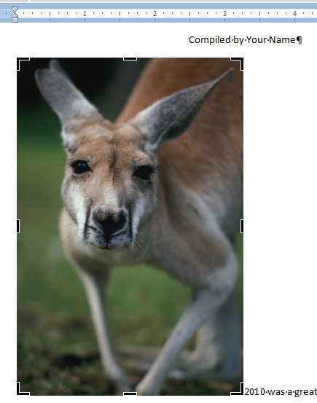
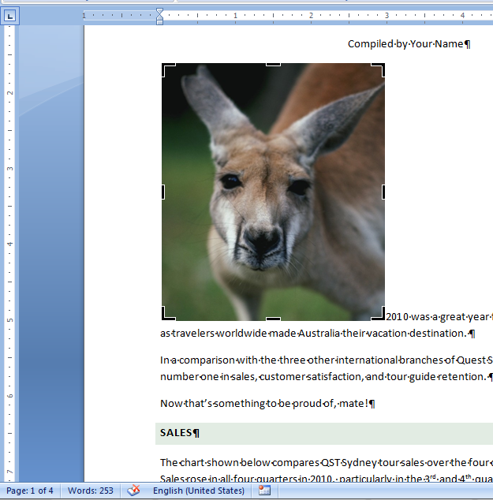
Modifying a Picture
Demonstration
Cropping a picture
Before
After
Notes:
Go to picture of flower: crop and add bevel and new shape;
Text wrapping
Encourage experimentation: check 3
They Do

Slide 21
Editing Charts
Modify charts with the tools contained on three Chart Tools contextual tabs
  Design tab: Modify the appearance and content of the chart itself
  Layout tab: Modify the appearance of the various chart components
  Format tab: Modify the appearance of the drawing canvas that contains the chart

Slide 22
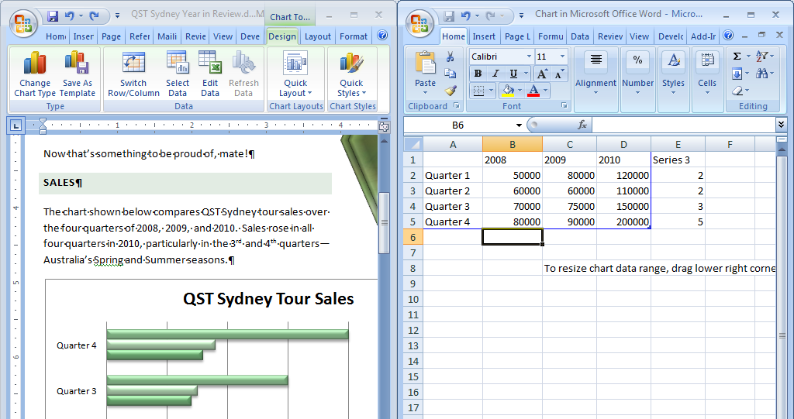
Editing Charts
New data for 2008
Adding new chart data
A third bar is added to each data series

Slide 23
Creating a SmartArt Graphic
You can create seven types of SmartArt graphics
  Once you have selected a type, you select a layout and then type text in each of the SmartArt shapes or in the text pane
  You can further modify a SmartArt graphic by changing fill colors, shape styles, and layouts

Slide 24
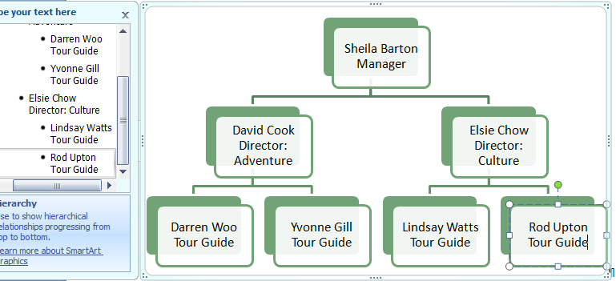
Creating SmartArt
Names and positions for organization chart
Notes:
Return to Demonstration: Go through charts
Create Smart Art organization chart
Create radial chart
They Do

Slide 25
Editing Clip Art
A clip art picture from the Clip Organizer is made up of a number of separate objects
  All of the objects are grouped together when you insert the clip art picture
  Ungroup a clip art to edit its individual objects
  The drawing canvas is an area upon which you can draw multiple shapes and insert clip art

Slide 26
Editing Clip Art
Two methods to convert a clip art picture into a drawing object:
  Right-click a clip art picture and select Edit Picture from the menu
  Change the clip art picture from an inline graphic to a floating graphic

Slide 27
Using Layering Options
The Arrange group includes commands to layer objects relative to each other
Layering options include:
  Bring to Front
  Bring Forward
  Bring in Front of Text
  Send to Back
  Send Backward
  Send Behind Text

Slide 28
Aligning, Distributing, and Rotating Graphics
The Align and Distribute option in the Arrange group includes commands you can use to change the relative positioning of two or more objects
  The Alignment commands align objects relative to each other: left, right, center
  The Distribute commands distributes the same amount of space between objects
  The Rotate command allows you to rotate an object on its axis
Notes:
Demonstrate Edit Clip Art
Layering Options
Align, Distribute, Rotate
They Do (have next slide visible)

Slide 29
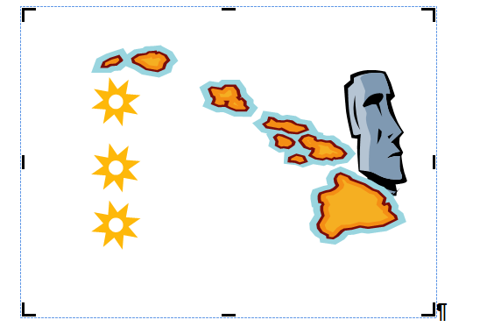

Formatted Pictures for Graphics Steps

Slide 30
Inserting a Watermark
A watermark is a picture or other type of graphic object that appears lightly shaded behind text in a document
Use pictures as watermarks – reduce brightness
Notes:
Demonstrate and they do

Slide 31
Working with References
Insert a Citation
Manage Sources
Generate a Bibliography
Insert an Equation
Modify an Equation

Slide 32
Inserting Citations
The Citations & Bibliography group on the References tab includes features to help you keep track of:
  Resources you use to write research papers
  Articles
  Any document you obtained from other sources, such as books and Web sites

Slide 33
Inserting Citations
A citation is a short reference, usually including the author and page number, that gives credit to the source of a quote or other information included in a document

Slide 34
Modifying Citations and
Managing Sources
Modify the contents of a citation
Edit the source of the citation
Format a citation for specific guidelines such as
  Chicago
  MLA
  APA

Slide 35

Generating a Bibliography
Assemble all your sources on a separate page or pages at the end of your document
You can choose to create a:
  Works Cited list: Lists only the works included in citations in your document
  Standard bibliography: Lists all the sources you used to gather information for the document
Demonstration
Notes:
Open file and review
They do

Slide 36
Inserting Equations
Use the Equations feature to insert mathematical and scientific equations from one of the categories in the Equation galleries
You can also create your own equations that use a wide range of math structures including
  Fractions
  Radicals
  Integrals

Slide 37
Modifying Equations
Use many of the formatting options in the Font and Paragraph groups on the Home tab to modify an equation
Choose to show an equation in:
  Professional Format
  Linear Format
Demonstration
Notes:
When formatting equation 1 – reduce the left and right margins so the box is smaller (work in Paragraph dialog box)

Slide 38
Building Forms
Construct a Form Template
Add and Modify Content Controls
Add a Building Block Content Control
Insert Legacy Forms Controls
Format and Protect a Form

Slide 39
Forms Design
A form is a structured document with spaces reserved for entering information
  Create a form as a template that includes labeled spaces, called form fields, into which users type information
  The form template can include check box fields, help messages, and other controls to make the form interactive

Slide 40
Constructing a Form Template
A Word form is created as a form template, which contains all the components of the form
  A field label is a word or phrase that tells users the kind of information required for the field
  A control is the placeholder inserted to contain data associated with the label

Slide 41
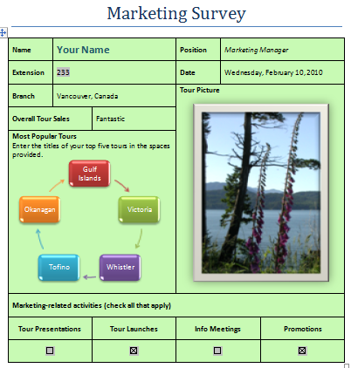
Constructing a Form Template
Rich Text
content control
Plain Text content control
Combo Box content control
Date Picker content control
Drop-Down List content control
Picture content control
Building Block content control contains text and a SmartArt graphic
Legacy Tools Check Box Form Field

Slide 42
Adding and Modifying Text Content Controls
Rich Text Content Control
  Use when you want formatting, such as bold or a different font size, automatically applied to text that users enter
Text Content Control
  Use when you do not want formatting applied or you want to format the entry with a style

Slide 43
Adding Date Picker and Picture Content Controls
Use the Date Picker content control to provide users with a calendar from which they can select a date
Use the Picture content control to provide a placeholder for users to insert a picture

Slide 44
Adding Drop-Down Content Controls
Drop-Down List Content Control
  Provides a list of choices
  Users can only select from the list
Combo Box Content Control
  Provides a list of choices
  Users can select from the list or they can type a new entry

Slide 45
Adding a Building Block
Content Control
You can create your own Building Block content control to insert into a form
  The Building Block content control can contain both text and objects, such as pictures and SmartArt graphics
Turn Design Mode off before you insert a Building Block content control

Slide 46
Inserting Legacy Forms Controls
Enhance a form by including Legacy Forms controls:
  Text Form Field
  Check Box Form Field
Work in the Text Form Field Options dialog box to customize a legacy form control

Slide 47
Formatting and Protecting a Form
Turn Design Mode off before you protect a form
Click the Protect Document button in the Protect group
Select the protection required:
  Filling in forms
Demonstration
Notes:
Make sure you save in Trusted Templates when you go File Save As Template.
Then it’s available in My Templates.

Slide 48
Customizing Word
Create a macro
Record macro steps
Edit a macro
Customize the Quick Access toolbar
Modify Options
Use the Document Inspector

Slide 49
Plan a Macro
Automate repeated tasks by using macros
  A macro is a series of Word commands and instructions that you group together as a single command to accomplish a task automatically

Slide 50
Planning a Macro
Macro tasks:
  Determine the tasks you want the macro to complete
Macro steps:
  Include the correct steps to perform the task
Macro information:
  Determine the information related to the macro
Record macro procedure:
  Use the Record Macro dialog box to record the macro

Slide 51
Creating a Macro
Create a macro by using the macro recorder or by entering codes into the Visual Basic Editor
For most routine macros, use the macro recorder
  Records each step you perform as a sequence of Visual Basic codes
For complex macros, use the Visual Basic Editor

Slide 52
Recording Macro Steps
Once you have created a macro, you need to record the macro steps
The macro recorder actually records each step you perform as a sequence of Visual Basic codes
  Can use the mouse to click commands and options
  Must use the keyboard to select text

Slide 53

Running a Macro
When you run a macro, the steps you recorded are performed
Run a macro in three different ways:
  Select the macro by name in the Macro dialog box, then click Run
  Click a button on the Quick Access toolbar if you have assigned the macro to the Quick Access toolbar
  Press a keystroke combination if you have assigned shortcut keys to the macro
Demonstration

Slide 54
Customizing the Quick Access Toolbar
Create a custom toolbar that contains only the buttons you want to perform specific tasks
  Can include buttons to perform macros

Slide 55
Using the Document Inspector
Use the Document Inspector to check that a document does not contain any
  Hidden text
  Personal information
  Comments that you do not want other users to see

Slide 56
Contact Information
Carol Cram
  Capilano University
  Course Technology Author
  Recent Titles:
    New Perspectives: Communicating in Business Portfolio Projects (May 2009)
    Microsoft Office Word 2007 Illustrated Second Course
    Microsoft Office Word 2007 for Medical Professionals
    Microsoft Office 2007 Illustrated: Integration Units A to F
    Microsoft Office 2007 Illustrated Projects
  Email: carolcram@shaw.ca

